Slide 1
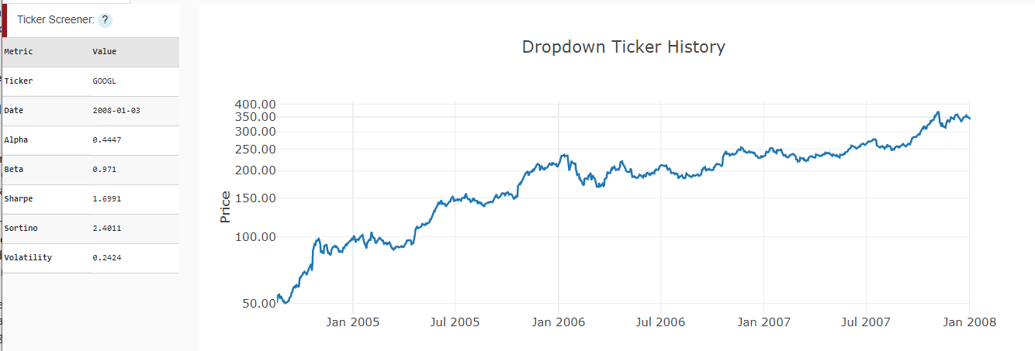
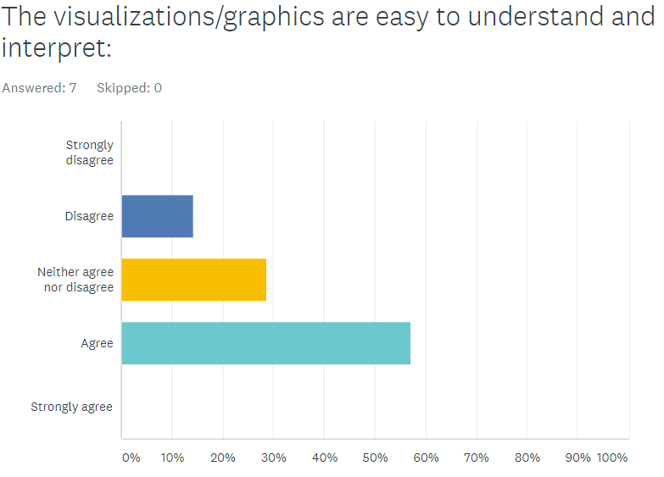
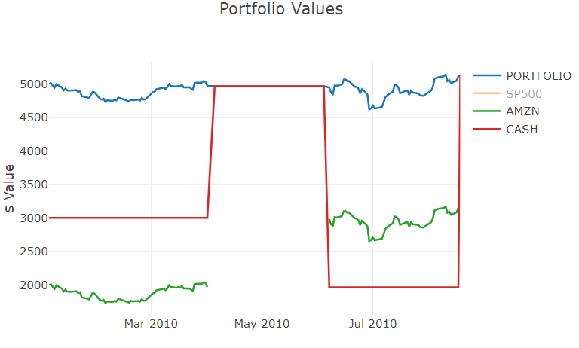
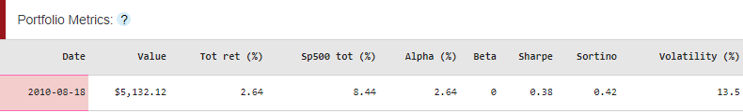
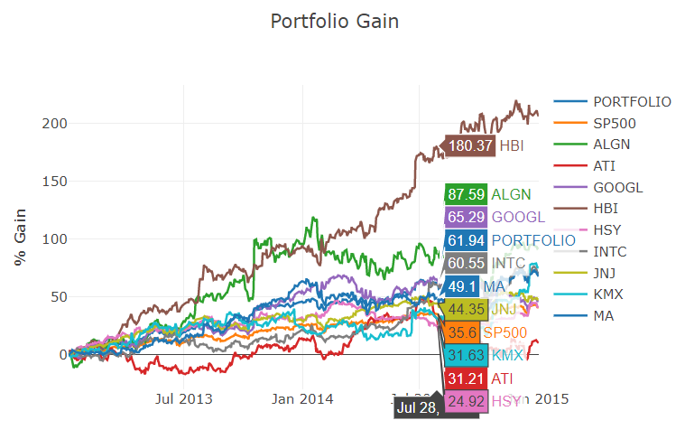
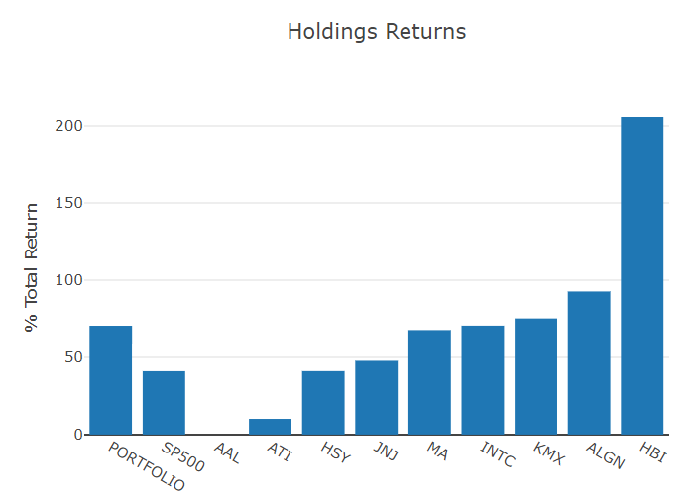
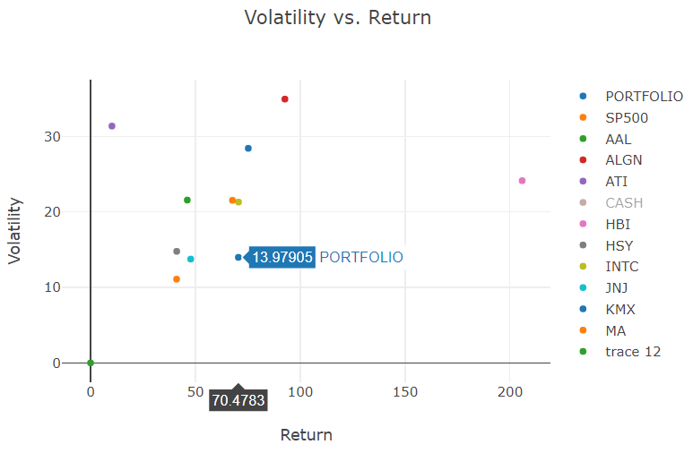
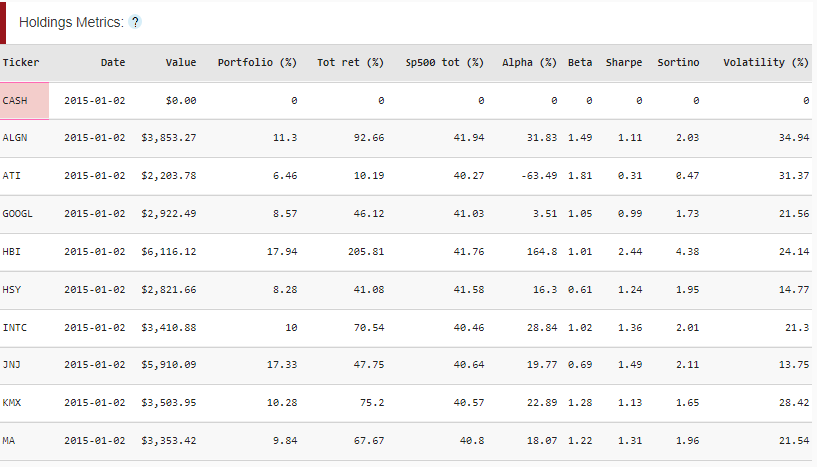
Team 113: Portfolio Management Tool
Richard Albright (ralbright7)
Patrick Chen (pchen43)
Ben Hurt (bhurt3)
Rabah Ouldnoughi (rouldnoughi3)
Overview
Data
Introduction:
There are many tools in the world for portfolio management, but have at least one of the following two problems:
They are not free
They are not simple to use or understand
Our project hopes to improve upon both of these aspects. The application we have built is a long-only stock portfolio management tool for analyzing historical performance of a user-defined portfolio ofstocks that is geared towards the individual investor. The tool will plot the return history and sources, and performance metrics of a portfolio entered by the user.
A free and beginner-friendly stock portfolio management tool will empower new investors to feel more confident and make more informed financial decisions. This will be of direct use to the DIY, individual, and non-institutional investor who doesn’t have access or necessarily the training to use more sophisticated applications.
The idea is to focus on answering the questions asked by the majority of individual investors performing this type of analysis, instead of pursuing a more complete response to all the answers an investor might ask.
Our data comes from the CRSP/Compustat database¹
How did we get it?
Downloaded full dataset from CRSP directly (free via Georgia Tech)
What is it?
Contains security-level data for more than 32,000 securities.
Daily price and return data for each security from 2007 through 2018
Original size is 43GB, reduced to 1gb after our manipulations
What did we do to it?
Trimmed the data down to the 707 current and previous constituents of the S&P500
Focused on daily return data and its manipulation
Computed metrics at both the holdings and portfolio level
Hosted in a database on Amazon RDS, using an E2 cluster to run our code
How did we display it?
Using the Dash application, made by Plotly, to display the data and calculations.
The resulting charts are all interactive: they allow for zooming in, cropping the view space, downloading as a .png, and including hovering tool tips.
Our Approach
Create a straightforward tool that is interactive, simple, and quickly shows information to answer the most common – and important – questions for the typical investor. This tool includes charts for historical stock prices, portfolio values and returns, and individual stock returns. There are also tables for portfolio and holdings metrics calculated from historical data. In order to improve user-friendliness, tooltips are provided in the application in a manner that is approachable to beginners, but unobtrusive to experts. The combination of easy-to-interpret interface and quick-to-use charts and tables delivers a product that meets the need we identified.
The analysis begins with the user’s entry of purchasing cash (to mimic the initial size of the portfolio – more can be added later):
Followed by entries of other transactions at whatever trade date the user desires:
From here, after each submission of a new transaction, the tool updates to show relevant information about the portfolio.
To assist with ticker selection, we provide a ticker chart that generates upon selecting a ticker in the above field. This displays before the decision is made to add the stock to the portfolio. It’s purpose is to give a summary of the position’s performance and statistics to make the buy decision more informed:
Results & Further Improvements
We Performed a user survey, results summarized below. Along with assessing our experiments, and comparing our tool to the existing methods.
User Survey
Taken by other Georgia Tech students, the majority of them believed our visuals were easy to understand. Their comments and feedback was used to develop the Further Improvements section below.
Experiments
Comparison to Portfolio Visualizer (“PV”, existing method), our tool:
Provides more results:
PV shows only portfolio return, an ownership pie chart, and annual returns
Operates using fewer interactions:
PV requires at least 10 clicks to get data, while ours requires at least only 4.
Is more flexible:
PV will only allow 1 period in its portfolio – one start and end date for everything
Our tool is dynamic across each position – every position can be different.
Is not as fast:
PV is faster – this is addressed below in Further Improvements
Once at least one position has been added, several charts and tables are updated to provide various information to the user. In order to test the functionality of the site, we show below a series of experiments that highlight the usefulness of each chart (all charts and tables are shown via these experiments).
Experiment 1: Buying and selling a position within the life of the portfolio (multiple times):
For this experiment, we bought and sold Amazon (AMZN) twice during 2010. We can see that upon the buys, the position is shown, and the portfolio’s cash amount drops by the value of the initial buy. Upon the sale of the AMZN position, the return history disappears (no returns to show), while the cash position increases by the value of the sale. The portfolio return moves corresponding to the performance of the respective positions, and in uninfluenced by the transactions themselves.
Further Improvements
Speed
Increasing the memory of the host cluster will make a remarkable impact on the response time of the webpage.
Better descriptions
Adding additional pages that provide look-throughs to the raw data (like a monthly-return summary table.
Add a help back to explain in more depth the purpose of the tools and graphs on the page.
Better Functionality
Provide upload/download options to push up pre-made transaction histories and pull down results.
Better charts
Poll a larger audience (of investors) to determine what other information investors are looking for, and adding accessible charts to the page to address those.
The portfolio-level metrics tracks the performance of the portfolio through the buys and sales of AZMN across the life of the experiment.
Experiment 2: Many positions:
This experiment was to test a couple of different features.
First is to show the utility of the on-chart tool tips where they might be otherwise-overwhelming (see the Portfolio Gain chart top left).
The Holding Returns bar chart (top middle) shows the absolute return of the individual stocks in an easy-to-consume format for quick comparisons.
The Volatility vs. return scatterplot (top right) gives the user a rough indication of the risk/return trade-off of the constituent members of the portfolio. This chart breaks down the pieces of the Sharpe ratio and plots them.
For more granular analysis, the Holdings Metrics table (left) shows more detailed measures including % of portfolio return, Alpha, Beta, Sharpe and Sortino ratios, and volatility. This table also shows the position value at the date chosen by the user.
References:
CRSP.com
https://www.portfoliovisualizer.com/backtest-portfolio

